Slide 1
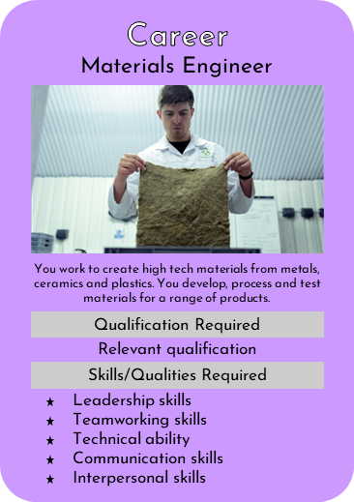
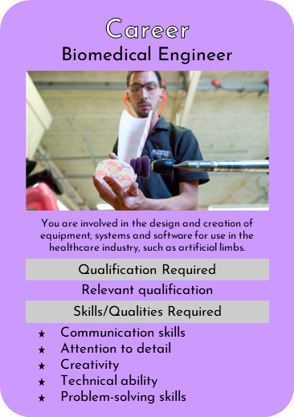
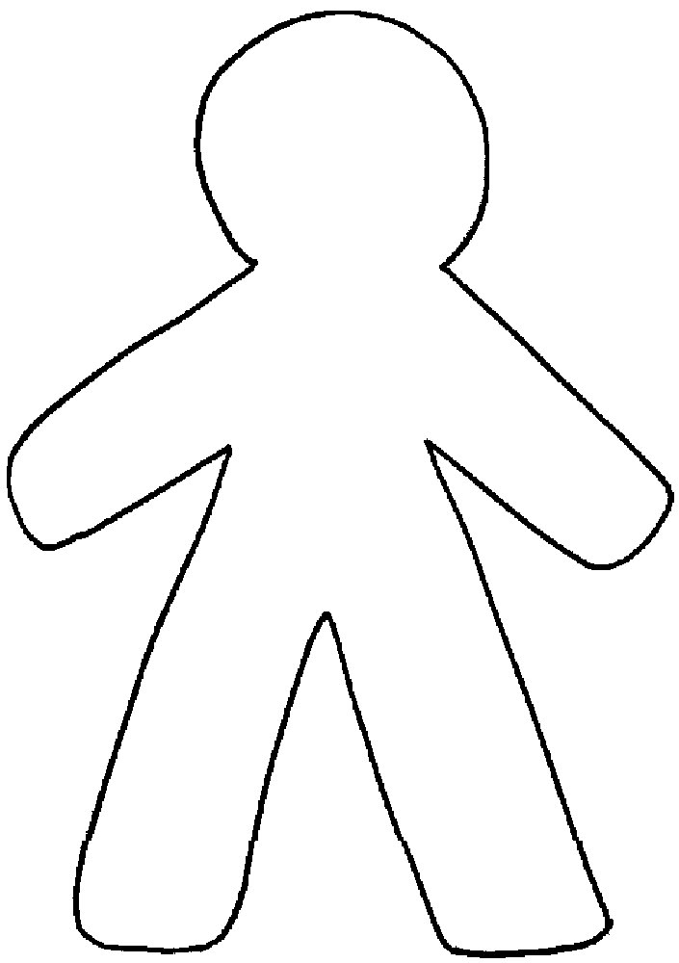
Career Characters
Group Activity
Aims
To consider what qualities someone in a certain career might have.
To address and challenge potential stereotypes.
Activity
Pick a career card from the CANDOO® card set.
Working as a group, draw what you think a person working in that career might look like. Consider:
What is their gender?
What are they wearing and why?
Are they carrying anything? What might they need for this career and why?
Around the edge, write words which you might associate with someone in this career.
Present your career character to the other learners.
The rest of the group should consider their character and come up with points for discussion. For instance:
Would you challenge any of the elements of the character? Why?
Is there anything you particularly agree with about their character?
Support:
Provide key words to give learners ideas about qualities or skills
Provide question or sentence starters to support learners with discussion
Resources
A3 printed cartoon character outline, available from ukstem.uk/candoo
Colouring pens/pencils
© UK STEM Ltd. 2022

